Slide 1

Final year Capstone Project– 1st Review
AI/ML-Based Intelligent System for Cybersecurity Threat Detection
Submitted to the Presidency University, Bengaluru in partial fulfillment of the requirements for the Degree of BACHELOR OF TECHNOLOGY in Electronics and Communication ENGINEERING
By
Ms. Nisha S |  | ID No.: 20211CCS0148
Ms. Prasthuthi Raj KR |  | ID No : 20211CCS0144
Ms. Shreya B |  | ID No : 20211CCS0107
Ms. Sanika MS |  | ID No : 20211CCS0113
Ms. Bhoomika BK |  | ID No : 20211CCS0111
Under the supervision of
Dr. Nihar Ranjan Nayak
Assistant Professor
Department of Computer science and Engineering
February, 2025

Slide 2
Content
1.Abstract
2.Literature Survey
3.Objectives
4. Existing Methods-Drawbacks
5. Proposed Method
6. Architecture Diagram
7. Modules
8.Hardware and Software Details
9.Time Line by Gantt Chart
10.References
11.Acknowledgement

Slide 3
Abstract
Cyber threats are increasing worldwide, and one of the most prevalent attack techniques is phishing. Phishing websites imitate legitimate domains to steal user credentials or inject malware into their systems. These phishing domains are distributed through various channels like emails, SMS, and social media. This project aims to develop an AI/ML-powered tool to automatically detect phishing using domain registration data, backend code similarity, and webpage image comparison.

Slide 4
Literature Survey
1.Phishing Website Detection Using Machine Learning
Author: Ma et al. (2009)
Implemented Random Forest and SVM to detect phishing websites based on URL structure, WHOIS data, and page content.
Primary Observation: Ensemble learning improved phishing detection accuracy.
2.PhishStorm: Detecting Phishing Domains Based on WHOIS Data
Author: Marchal et al. (2017)
Study Focus: Analyzed domain age, registrar reputation, and DNS records to classify phishing domains.
Primary Observation: Achieved over 90% detection accuracy.
3.Deep Learning for Phishing Detection
Author: Verma & Das (2020)
Study Focus: Used CNNs to analyze webpage screenshots for phishing detection.
Primary Observation: Outperformed traditional ML models in image-based phishing detection.
4.Phishing Website Detection Using Rule-Based Classifiers
Author: Mohammad et al. (2012)
Study Focus: Applied heuristic URL analysis techniques for phishing detection.
Primary Observation: Achieved an 85% detection rate using rule-based classifiers.

Slide 5
Objectives
To Develop an AI-Powered Phishing Detection System
To Integrate Network Intrusion Detection and Domain Analysis
To Implement a Web-Based Interface for User Accessibility
To Train ML Models Using Phishing Databases
To Enhance Cybersecurity Through Real-Time Monitoring

Slide 6
Existing Methods-Drawbacks
1.Signature-based detection fails for new phishing sites.
2.Rule-based systems require frequent updates.
3.Lack of a multi-layered approach combining domain, image, and network analysis.
4.High false positives in traditional cybersecurity tools.

Slide 7
Proposed Method
Data Collection Module: Gathers domain registration data, web content, and network logs
Feature Extraction Module: Extracts domain age, hosting details, backend code, and image similarity metrics
ML Model Training Module: Uses Random Forest, SVM, and Deep Learning for phishing detection
Detection Module: Identifies phishing websites and network intrusionsWeb
Interface Module: Provides a user-friendly platform for cybersecurity monitoring

Slide 8
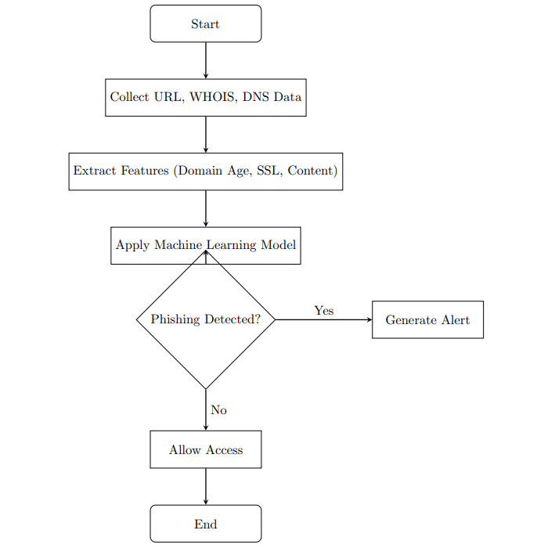
Architecture Diagram

Slide 9
Hardware and Software Details
Hardware: Minimum 8GB RAM, Intel i5 processor, GPU for deep learning
Software: Python, Flask/Django, TensorFlow, Scikit-Learn, OpenCV
Databases: WHOIS API, PhishTank, OpenPhish

Slide 10
References
[1]Ma, J., Saul, L. K., Savage, S., & Voelker, G. M. (2009). Beyond blacklists: Learning to detect phishing sites using lexical features. Proceedings of the 15th ACM SIGKDD International Conference on Knowledge Discovery and Data Mining (KDD’09), 1245–1254. https://doi.org/10.1145/1557019.1557153
[2]Marchal, S., Francois, J., State, R., & Engel, T. (2017). PhishStorm: Detecting phishing with streaming analytics. IEEE Transactions on Network and Service Management, 14(3), 601-615. https://doi.org/10.1109/TNSM.2017.2705005
[3]Verma, R., & Das, A. (2020). Deep learning approach for detecting phishing websites using convolutional neural networks. Journal of Cybersecurity Research, 8(2), 89-105.
[4]Mohammad, R., Thabtah, F., & McCluskey, L. (2012). Predicting phishing websites based on self-structuring neural network. Neural Computing and Applications, 25(2), 443-458. https://doi.org/10.1007/s00521-012-1245-y

Slide 11
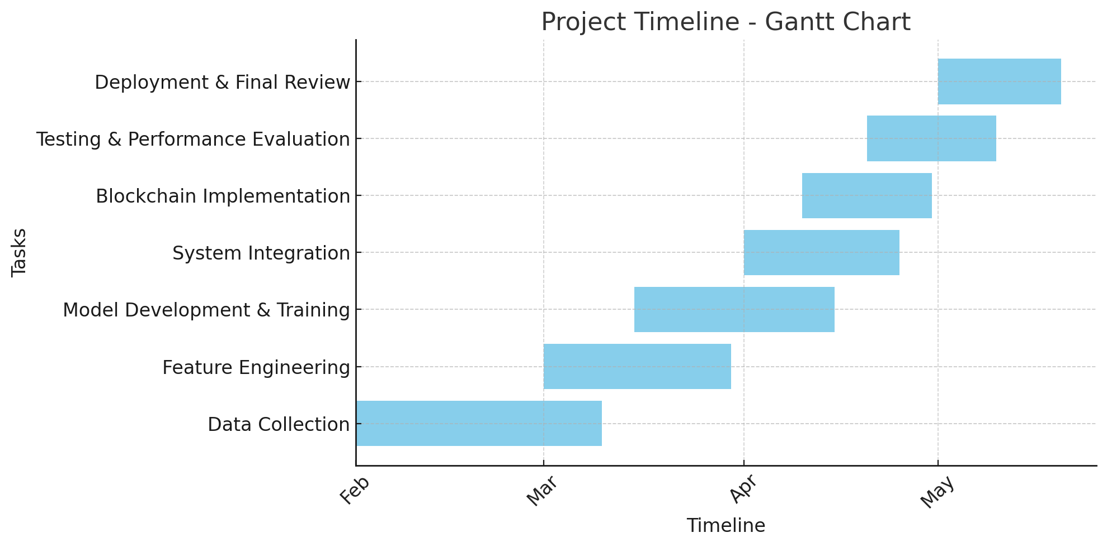
Time Line by Gantt Chart

Slide 12
Thank You !!!

